Slide 1
The Periodic Table & Classification of Elements
1. A brief Intro to Mendeleev’s Periodic Table:
The Periodic Law
2. Modern Periodic Table
3. Classifying Periodic Table:
Groups & Periods
Main Groups & Transition Metals
4. Prediction of New Elements

Slide 2
Mendeleev’s Periodic Table
Mendeleev proposed that the properties of the chemical elements repeat at regular intervals when arranged in order of increasing atomic mass.
Can you think of some of the properties he might have studied?

Slide 3
When the elements are arranged in order of increasing mass, certain sets of properties recur periodically.

Slide 4
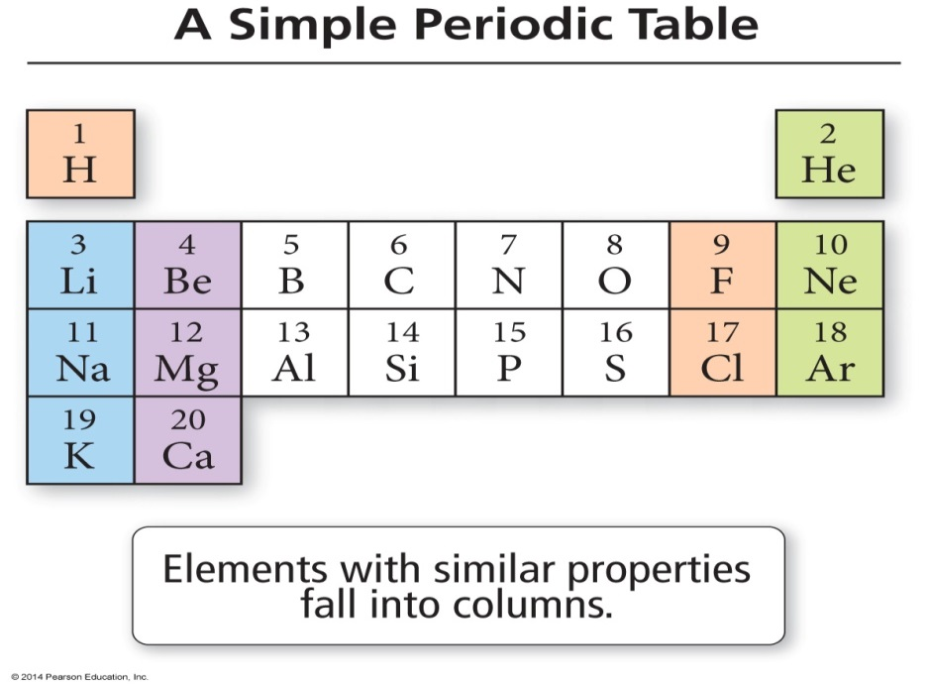
Mendeleev’s Periodic Table
Mendeleev organized the known elements in a table so that elements with similar properties fall in the same vertical columns.

Slide 5
Modern Periodic Table
Moseley discovered if elements are arranged by increasing atomic number rather than atomic mass, the repeating pattern of properties of elements can be better explained
The modern periodic law states that the properties of the elements repeat when the periodic table is arranged according to increasing atomic number

Slide 6
Periodic Table
Example 1
Let’s locate elements in the modern periodic table , whose arrangement violates Mendeleev’s periodic law?

Slide 7
Periodic Table
The periodic table is divided into vertical columns and horizontal rows.
Each vertical column is called a group (or family).
Each horizontal row is called a period.
There are a total of 18 groups and 7 periods.

Slide 8
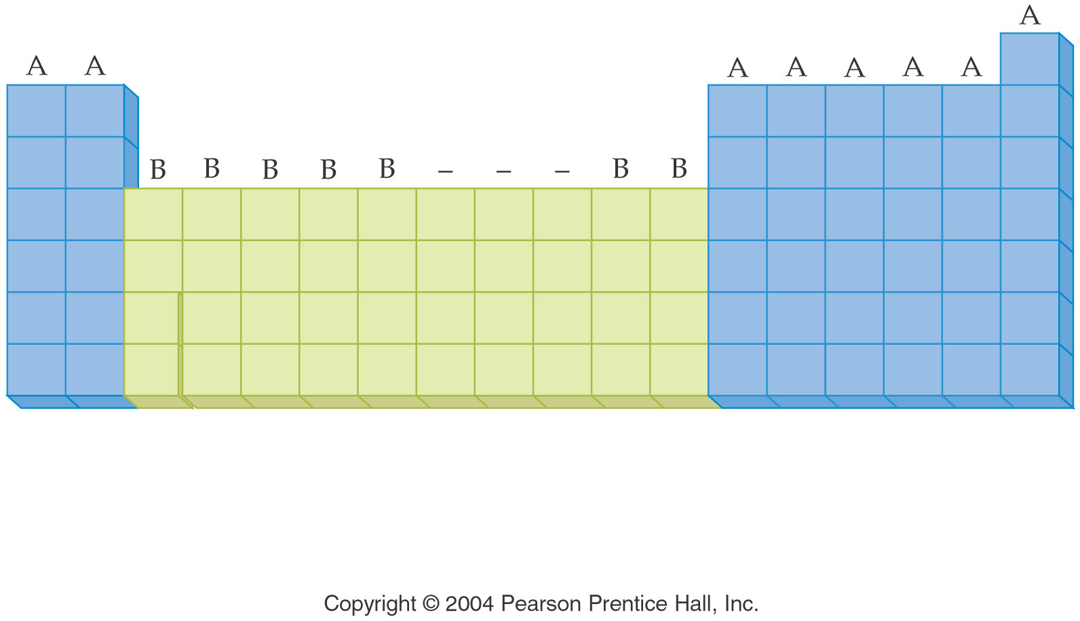
Periodic Table
American chemists designated the groups with a Roman numeral and the letter A or B.

Slide 9
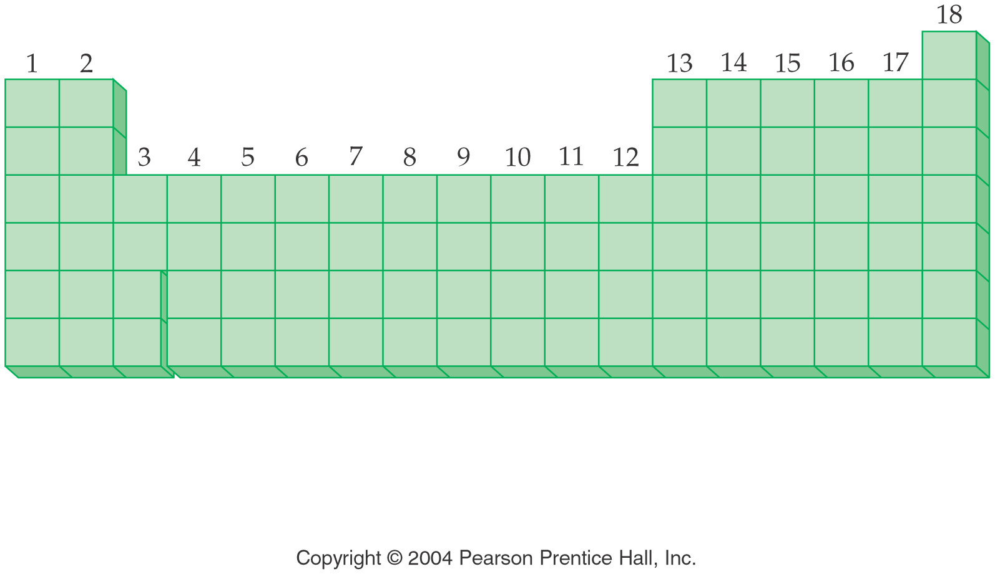
Periodic Table
In 1920, the International Union of Pure and Applied Chemistry (IUPAC) proposed a new numbering scheme. In it, the groups are assigned numbers 1 through 18

Slide 10
Periodic Table
Example 2
What term refer to a horizontal row in the periodic table of elements?
(a) group or family
(b) group or series
(c) period or family
(d) period or series

Slide 11
Periodic Table
Example 3
Would you place the elements Li, Na & K in the same ‘group’ or the same ‘period’ ?
Example 4
Would you place the elements Y, Ag & I in the same ‘group’ or the same ‘period’ ?

Slide 12
Periodic Table
The periodic table can also be divided into
main-group elements, whose properties tend to be largely predictable based on their position in the periodic table.
transition elements or transition metals, whose properties tend to be less predictable based simply on their position in the periodic table.

Slide 13
Periodic Table

Slide 14
Periodic Table
Main-group elements(also called Representative elements) are in columns labeled with a number and the letter A (1A–8A or groups 1, 2, and 13–18).
Transition elements are in columns labeled with a number and the letter B (or groups 3–12).

Slide 15
Periodic Table
Example 5
Which one of the following sections does ‘Hg’ belong to ?
(a) Rare elements
(b) Main Group elements
(c) transition elements
(d) inner transition elements

Slide 16
Periodic Table
Example 6
What is the term for the elements in Groups 3–12?
(a) rare earth elements
(b) representative elements
(c) transition elements
(d) inner transition elements

Slide 17
Periodic Table
Example 7
Which one of the following sections does ‘In’ belong to ?
(a) Rare elements
(b) Main Group elements
(c) transition elements
(d) inner transition elements

Slide 18
Some families have common names.
Noble Gases:
The group 8A elements, called the noble gases, are mostly unreactive.

Slide 19
Some families have common names
The group 1A elements, called the alkali metals, are all reactive metals.
The group 2A elements are called the alkaline earth metals:
fairly reactive, but not quite as reactive as the alkali metals

Slide 20
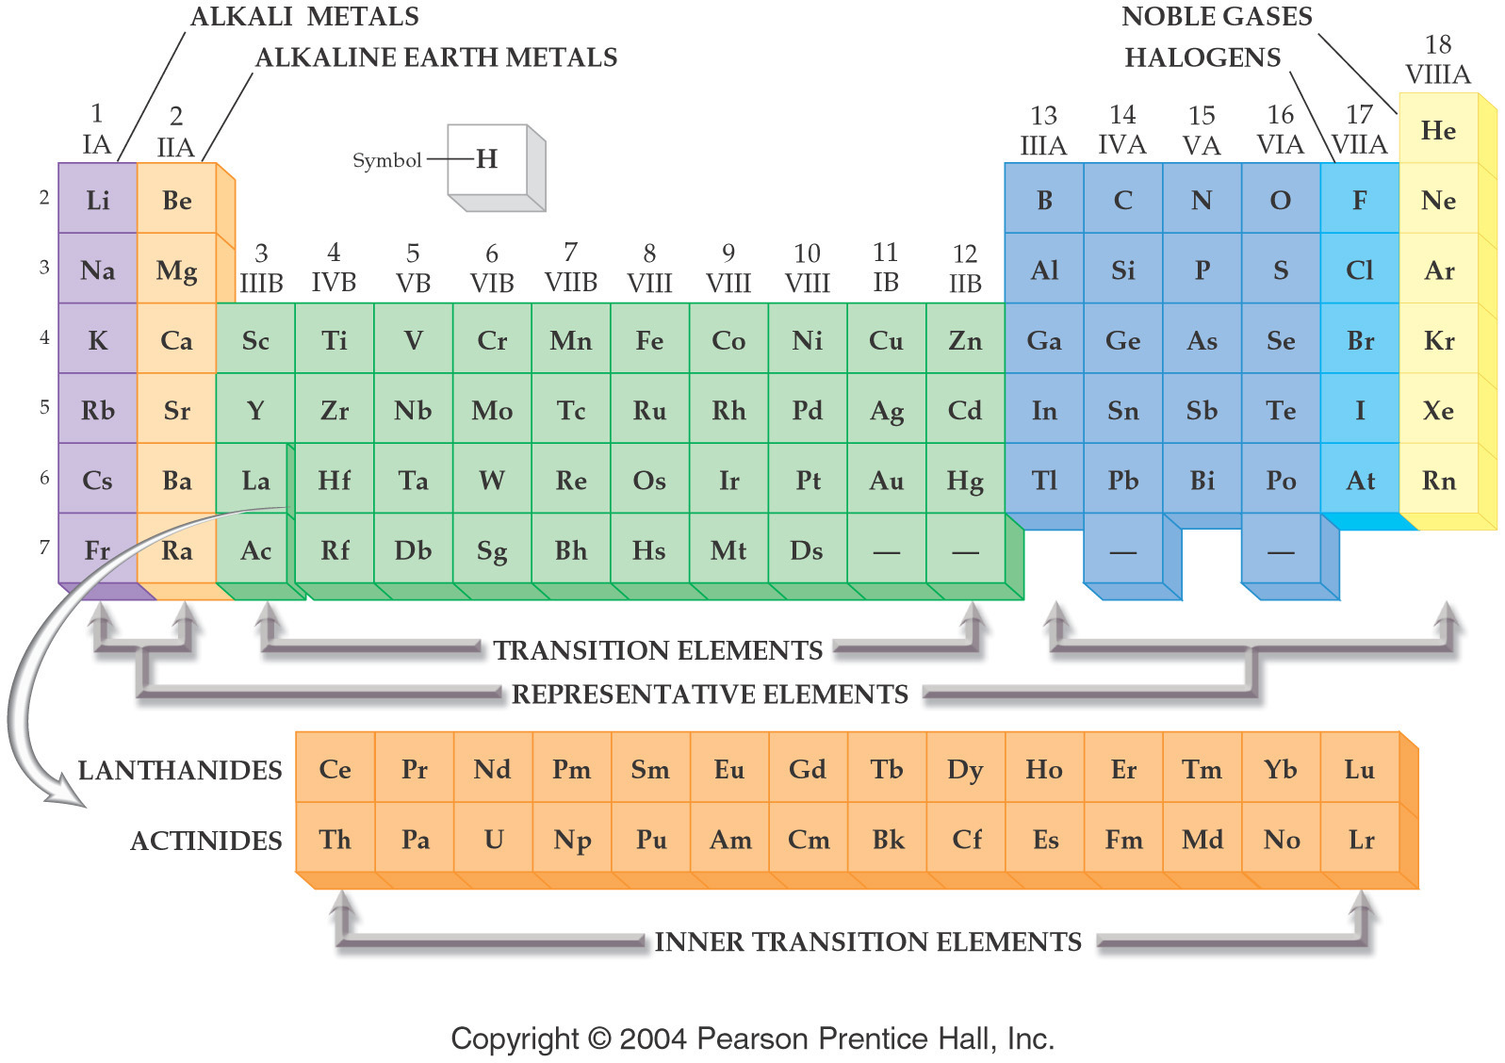

Slide 21
Prediction of New Elements
Mendeleev noticed that there appeared to be some elements missing from the periodic table.
He was able to accurately predict the properties of the unknown element ekasilicon in 1869. It was discovered in 1886 as germanium.

Slide 22
Prediction of New Elements

Slide 23
Prediction of New Elements

Slide 24
Prediction of New Elements
Based on periodic trends, Mendeleev predicted the existence of three elements (gallium, scandium, and germanium) before they were discovered.
He narrowly missed being awarded the Nobel Prize in 1906

Slide 25
Prediction of New Elements
Example 8
Predict the density for rhodium, Rh, given the density of cobalt, Co, (8.89 g/cm3) and iridium, Ir, (22.65 g/cm3).
(a) 2.01 g/cm3
(b) 6.88 g/cm3
(c) 13.76 g/cm3
(d) 15.77 g/cm3

Slide 26
Periodic Trends
The arrangement of the periodic table means that the physical properties of the elements follow a regular pattern
There will be three properties that will be studied in this chapter:
Atomic Radius
Metallic Character
Ionization Energy

